Slide 1
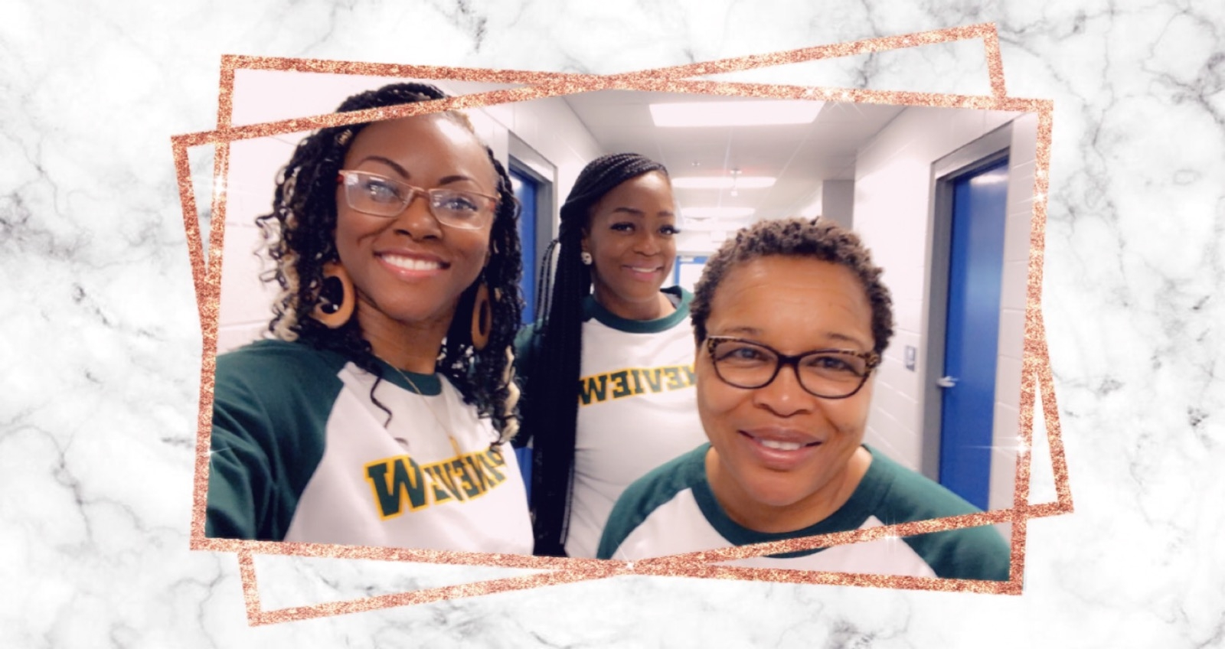
Welcome to First Grade!

Slide 2
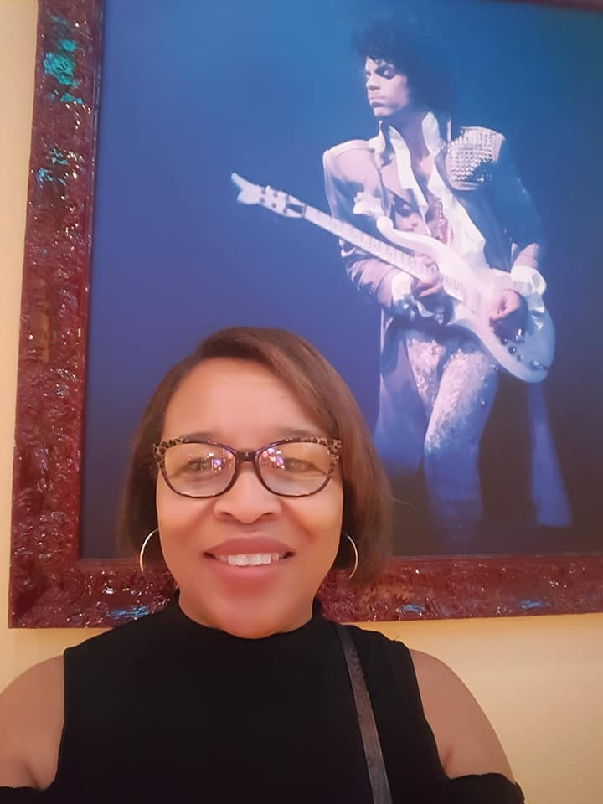
It is me
Hi
Mrs. Barnes-Williams a native of Tallahassee, Florida, married with two sons and two granddaughters.
My current passion is photography. I have the honor of capturing the Florida State University Football team’s home games for the past 3 years. It through being self-taught in photography that I value learning and teaching.
I am a teacher veteran teacher certified in the areas of Pre-kindergarten through Third Grade. I exhibit a vast amount of experience in teaching students in the academic grades of Prekindergarten through Third Grades
I recently obtained a Master’s Degree in Curriculum and Instruction. I am realizing that education is always going to be a part of what drives me. Therefore, I have made a commitment to myself, to re-invent me.
My mantra is to learn something new everyday. I seek to maintain that goal. It can be something monumental or something minuscule.

Slide 5
What is CLASSLINK?

Slide 6
ClassLink is an online portal to all your child’s instructional programs. It allows students to use all their programs without the need to memorize multiple usernames and passwords. Each student’s page is individualized based upon their courses, grade, and school. Please see the directions below to access ClassLink from home.
1. Go to LCS Website
2. Click classlink
3. UN: Studetnt#@edu.leonschools.net PW:

Slide 7
DIGITAL ACADEMY

Slide 8
Digital Academy Etiquette
Unmuted: If you need to speak
Muted: Entering the classroom
Video icon must be on during class.

Slide 9
Digital Academy Etiquette
Raise your hand to speak

Slide 10
Come to class on time.
KEEP MIC MUTED

Slide 11
Digital Classroom Expectations
Each student is expected to:
Use the restroom before class starts.
Participate during all live instructional time.
Have all materials near your desk or workstation.
Not have food or drinks near work area.
Work independently on assignments as much as possible.

Slide 12
Instructional Materials
White Board
ELA Materials Needed:
2-Sharpened Pencils
Erasers
Workbooks
Math Materials:
Student Book
Manipulatives as needed
Science
Social Studies

Slide 13
Daily Schedule
9:40-9:55….…………………………………………………………………………...Starfall
9:55-10:…………………………………………………………………………………..……ELA
Concept Introduction
Phonological Awareness/Phonics
Reading
Writing
Grammar
9:40-10:00……………………………………………………..…..Independent Work
Wonders Practice Workbook (pages outlined daily)
10:00-10:30……………………………………………….…………I-Ready Computer
10:30-10:35…………………………………………………………....Restroom Break
10:35-11:00 …………………………………………………………………………..Writing
11:00-11:25 ………………………………………………………………………A R Reading
11:20-11:50 …………………………………………………………………..…...…Science
11:50- 12:20 …………………………………..Lunch
Math

Slide 14
BRICK & MORTAR

Slide 15
Student and parents Safety Protocol
Parents will not be allowed on campus per district policy, however, provisions will be made for PK parents.
Parents must have an appointment to come on campus (i.e.: student registration). Parent/teacher conferences should occur via Zoom or TEAMS.
The office must be notified of the date and time when an appointment has been made with a parent. Parents are required to follow the LCS guidelines when on campus, they must have their temperature checked and wear a mask.
Students will enter campus from car drop off, pedestrian gate, and the bus loop.
Staff will be stationed at all student arrival locations for temperature checks. Staff will also have additional masks for students who forget their mask at home.
Students showing Covid symptoms (ie-upset stomach, temperature, etc.) will go to the Triage Room (room 25 in building 2).
Parents dropping off students must stay in the drop off loop and will not be allowed to park and walk up their student to the front of the school. PK parents will be the only exception.
Students will stay in their car until their temperature has been taken.

Slide 16
Student and parents Safety Protocol cont…
PK parents will have a designated gate (farthest gate by the 200 building) to enter the campus. A PK para will be stationed there and take temperatures before allowing PK parents and their student to enter the campus and walk their student to class. PK parents must drop off their student without entering the classroom and exit the campus.
Students coming off buses are temperature checked as they exit the buses.
Students will go directly to their designated area.
Breakfast will be served in the classrooms starting at 7:45.

Slide 17
Classroom Safety
Mask will be worn at any time that social distancing (6 feet) is not possible.
common areas will be wiped down (countertops, tables, doorknobs, bathroom fixtures, phones, keyboards) as much as possible.
Students will not be sharing materials unless sanitizing in between is possible.
Students, teachers and parents will use Canvas for written communication
Remind will be used to communicate in lieu of behavior
Students are encourage to bring their own water bottles to school.

Slide 18
DAILY SCHEDULE
8:15-8:25 Morning News & Harmony
8:25- 8:45 Morning Routine
8:45-10:55 Reading
10:55-11:20 Lunch
11:20-11:40 Recess
11:40 -12:20 Special Area
12:20-12:45 Writing/Science
12:45- 1:45 Math
1:45-2:20 Small Group ELA
2:20-2:50 Lab

Slide 19
Expectations
BE RESPECTFUL
BE RESPONSIBLE
BE SAFE
BE A TEAM PLAYER

Slide 20
Homework
It is recommended that your child reads independently or with a parent/guardian every night for at least 20 minutes. Besides this, your child will have a math practice page nightly which will reinforce the skills and concepts being taught in the classroom. They will also receive weekly spelling practice activities.
If you would like any additional practice pages to reinforce concepts at home, do not hesitate to ask! I would be more than happy to provide you with practice pages to work with your child at home.

Slide 21
Resources and Monitoring
CANVAS
(Assignments will be completed through Canvas)
Wonders
Go Math
I-Ready: Reading and Math
Reflex Math
Lexia Cores
MyOn
Accelerated Reader
STAR: Reading and Math

Slide 22
